Slide 1

Information Asset Security and Control
Information Systems Auditing
Class VI

Slide 2
Class Recap

Slide 3
Class Roadmap
IT Governance: Concept
IT Governance: Audit Program
IS Acquisition and Development
IS Implementation
IS Operation & Business Resilience
Protection of Information Assets I: Part A
Protection of Information Assets II: Part B
Mid-Term Exam
Basic of Data Analysis
Risk and Control
Parallel Simulation
Analytics and Sampling
Substantive Testing: Sales Cycle
Substantive Testing: Expenditure Cycle
Audit Report
Final Exam

Slide 4
Covered So Far
IT Governance and its audit concept through COBIT 2019 standard
How Systems are Acquired & Developed
How Systems are Implemented
How to make sure the system is running well and prevented to have prolonged downtime
Remember, the first half of this class will cover domains in CISA Review, as follows:
IS Auditing Process
IT Governance
IS Acquisition, Development, and Implementation
IS Operations and Business Resilience
Protection of Information and Assets

Slide 5
Reflection on Filling-Up Mind-Map Assignment
How long did it take for you to finish your part?
Do you have any alternative idea to fill the mind-map?

Slide 6
Intro: The Big Story
Why and What We Protect
Trust and Responsibility Over Data
Access to the City: Who May Enter
Defending the Infrastructure
Protecting the Data Itself
Modern Computing Environments

Slide 7
Intro
#protect #control #trust

Slide 8
What This Chapter is About?
Before we go into details, this chapter answers one big question:
How does an organization design and implement controls to protect information assets?

Slide 9

Let’s Protect the City
I recently have been playing Age of Empires II.
This game incorporates the skills on how to defend our base/city
Let’s see what we can do to protect the city

Slide 10


Part A vs Part B of Chapter 5
We are focusing on:
Design of protection
Preventive and foundational controls
Trust, access, and safeguarding mechanisms
We are NOT yet covering:
Attacks and hacking techniques
Security monitoring and testing tools
Incident response and forensics

Slide 11
Part A vs Part B Topics
Part A: Information Asset Security and Control
Information Asset Security Frameworks, Standards, & Guidelines
Privacy Principles
Physical Access and Environmental Controls
Identity and Access Management
Network and End-point Security
Data Classification
Data Encryption and Encryption-related Techniques
Public Key Infrastructure (PKI)
Web-based Communication Technologies
Virtualized Environments
Mobile, Wireless, and Internet-of-Things (IOT) Devices
Part B: Security Event Management
Security Awareness Training and Programs
Information System Attack Methods and Techniques
Security Testing Tools and Techniques
Security Monitoring Tools and Techniques
Incident Response Management
Evidence Collection and Forensics

Slide 12
Part A Topics’ Brief Explanation
No | Topics | Brief Explanation
1 | Security Frameworks | Rules before tools: protection must be structured and intentional
2 | Privacy Principles | Respect the citizen: personal data must be handled with care and purpose
3 | Physical & Environmental Controls | Protect the buildings: no digital security works if the room burns
4 | Identity & Access Management | Only the right people get the keys
5 | Network & Endpoint Security | Defend the walls and houses
6 | Data Classification | Not all valuables need the same lock
7 | Encryption | Even if stolen, it stays unreadable
8 | PKI | Trust needs a trusted third party
9 | Web-based Technologies | Public-facing systems need extra caution
10 | Virtualized Environments | Shared buildings need strong separation
11 | Mobile, Wireless & IoT | Assets now move beyond the city walls
Part A is about building protection correctly—before testing, monitoring, or responding to incidents.

Slide 13
What and Why We Protect
Setting the rules and defining what matters

Slide 14

What Is an Information Asset?
An information asset is anything that supports business value through information.
Examples:
Data (customer, financial, employee)
Applications (ERP, HR, core systems)
Infrastructure (servers, networks)
Identities & credentials
Inside the city, not everything has the same value

Slide 15
Why Knowing This Matters?
You cannot protect what you do not recognize
Overprotection wastes resources; underprotection creates risk
Keywords:
Value – Why does it matter?
Ownership – Who is responsible?
Risk – What happens if it fails?
Auditor lens:
Are information assets formally identified?
Is ownership clearly assigned?
Is protection aligned with business importance?

Slide 16
Then What is “Secure”?
What makes the city feel safe?
What “secure” means
If I say a system is secure, what do I actually mean?

Slide 17
The “Secure” City
The city is not safe just because it has walls.
A city is safe when:
Only the right people can access restricted areas
Official records are not secretly altered
Essential services keep running, even during problems
“In information security, we summarize all of that into three words.”

Slide 18

Security Objectives (CIA Triad)
What makes the city feel safe?
Integrity
nothing is altered improperly
I
InfoSec
Objectives
Confidentiality
only the right people can see
Availability
accessible when needed
C
A

Slide 19
Information Asset Security Frameworks, Standards & Guidelines
If CIA tells us what security must achieve, frameworks tell us how to organize controls to achieve it.
CIA = What the city wants (safety goals)
Frameworks = City laws and building codes
Controls = Locks, guards, alarms
A city without laws may still have guards, but:
No consistency
No accountability
No common standard

Slide 20

What Is a Security Framework?
A security framework is a structured way to organize security controls so they consistently support business objectives.
Frameworks provide:
Common language
Defined domains
Clear responsibility
They answer:
What controls should exist?
How they relate to each other?
Who is accountable?
Remember what we covered in week 2 about criteria

Slide 21
Frameworks vs Standards vs Guidelines
Frameworks | High-level structure Organizes control areas Used for governance and audit alignment
Standards | Mandatory requirements Must be complied with
Guidelines | Recommended practices Flexible, context-based
Procedures (Preview) | Step-by-step execution Operational level
The Map
The Rules
The Advices
The Daily Instruction

Slide 22

Why Auditors Care
Auditors do not audit tools first. They audit:
Whether a framework is adopted
Whether controls align with it
Whether it is applied consistently
Frameworks exist to ensure CIA objectives are achieved consistently, not accidentally.
Without frameworks:
Confidentiality depends on individuals
Integrity depends on trust
Availability depends on luck
Typical audit red flags:
Controls exist, but no framework
Policies exist, but no procedures
Inconsistent implementation across units
Procedures exist, but are outdated
Guidelines are treated as standards (over-control)

Slide 23
Trust and Responsibility Over Data
When information represents people, not just systems

Slide 24

The “Secure City”
Imagine a city where the guards know everything about every citizen: where they live, where they go, how much they earn
Even if the city is safe from enemies, would you want to live there?

Slide 25
Security vs Privacy
Security → Protecting the city from outsiders
Privacy → Protecting citizens from misuse by city authorities
An organization can be:
Secure but not privacy-respecting
Privacy-aware but technically weak
(Both must coexist.)

Slide 26
Privacy Principles
In security, we don’t only protect the city infrastructure.
We also protect the citizens who live inside the city.
Privacy principles define how the city treats its citizens’ personal information.
City → Organization
Citizens → Individuals (employees, customers)
Citizen records → Personal data
City authorities → Organization insiders
Privacy controls protect citizens from misuse of power inside the city, not just from outsiders.

Slide 27
Core Privacy Principles
Principle | Brief Definition | Audit Perspective
Collection Limitation | Personal data should be collected lawfully, fairly, and only to the extent necessary for specified purposes. | Is each data element clearly justified? Is excessive personal data being collected?
Purpose Limitation | Personal data should be used only for the specific, explicit purposes for which it was collected, unless further consent or legal basis exists. | Is data reused across processes? Is reuse formally approved and communicated?
Data Minimization | Personal data should be adequate, relevant, and limited, and retained only for as long as necessary. | Are retention periods defined? Are old records securely disposed of?
Transparency and Consent | Individuals should be informed about data collection and usage, and consent should be obtained where required. | Are privacy notices clear and accessible? Is consent documented and auditable?

Slide 28
Access to the City: Who May Enter
Controlling entry points before defending the inside

Slide 29

Physical Access Control
Protecting the city gates and buildings
Before securing systems and data, we must first secure its physical access
If attackers can:
Enter the city freely
Access buildings without restriction
Then all logical controls become meaningless.
Physical access controls are safeguards designed to prevent unauthorized physical access to facilities, systems, equipment, and resources.

Slide 30
Identity and Access Management (IAM)
Who gets the city keys, and what they can do
A city is not protected by walls alone, but by controlling who is allowed to do what inside the city.
IAM ensures that only the right people can access the right resources, in the right way, at the right time.
IAM defines identity, authority, and responsibility inside the city.
Identity and Access Management is a framework of policies, processes, and technologies used to identify users, authenticate their identities, and authorize access to resources.

Slide 31
IAM Pillars
Identification (Who are you?)
Identification is the process of claiming an identity, typically via a user ID or account.
The city records who you are before issuing any keys.
Authentication (Prove it!)
Authentication verifies that the claimed identity is valid.
Common methods:
Something you know (password)
Something you have (card, token)
Something you are (biometrics)
Authorization (What Are You Allowed to Do?)
Authorization defines what actions and resources an authenticated user is permitted to access.
Key principles:
Least privilege: To give every user, process, or system the bare minimum permissions needed to perform its job and nothing more
Role-based access: To simplify management by assigning permissions to defined roles (e.g., "Developer," "Manager," "Auditor") rather than to individual users. Users inherit the permissions of the role(s) they are assigned.

Slide 32
Defending the Infrastructure
Protecting networks and devices that process data

Slide 33
Environmental Controls
Protecting the city from fire, flood, and power failure
Even a well-guarded city can fall if nature or infrastructure fails.
Environmental controls protect the availability and integrity of information assets against non-human threats.
Environmental controls ensure the city continues to function even under adverse conditions.
Remember what we covered in week 5 about business resilience
Environmental controls are safeguards designed to protect information assets from physical and environmental threats, including fire, power failure, temperature, humidity, and natural disasters.

Slide 34
Network and Endpoint Security
Protecting the city roads and individual homes
Even with strong gates and trusted citizens, a city collapses if its roads are unsafe and homes are unprotected.
Network and endpoint security protect:
Data in transit
Devices that access the city
This layer controls how traffic flows and where it is allowed to go.

Slide 35
Network and Endpoint Control Examples
 | Brief Explanation/Examples | City Analogy
Network Security | Firewalls (traffic control) Network segmentation (zoning) Intrusion detection/prevention | Roads must allow legitimate traffic while stopping smugglers.
Endpoint Security | Anti-malware Host firewalls Patch management Device hardening | Each house must lock its doors, not rely only on city guards.
Remote Access | Remote access should be authenticated, encrypted, and monitored. Common controls: VPN Strong authentication | Merchants entering from outside must pass controlled gates

Slide 36
Protecting the Data Itself
Assume systems may be compromised,
protect the asset directly

Slide 37
Data Classification
Identifying the city’s ordinary assets and crown jewels
Not everything in the city deserves the same level of protection.
Data classification helps the organization:
Focus controls where they matter most
Avoid over- or under-protection
Data classification defines how valuable and sensitive each asset is.
Classification drives:
Access controls
Encryption
Retention
Handling procedures

Slide 38
Typical Classification Levels
Level | Brief Explanation | City Analogy
Public | Low risk if disclosed | City announcements posted on walls.
Internal | Limited exposure risk | City operations known to officials.
Confidential | High impact if leaked | Tax records, employee data.
Restricted / Secret | Severe impact if compromised | Crown jewels, military plans.
Controls must be risk-based
Misclassification leads to:
Waste
Exposure
Audit findings

Slide 39
Data Encryption & Encryption-related Techniques
Once the city knows which assets are valuable, it must decide how to lock them properly.
Encryption protects data even when other controls fail.
Encryption ensures that even if thieves enter the city, they cannot use what they steal.
Encryption is the process of transforming data into an unreadable format using cryptographic algorithms, so that only authorized parties can access it.
encrypt
decrypt
data awal -> fsys ses;
mhsmyil -> ????

Slide 40
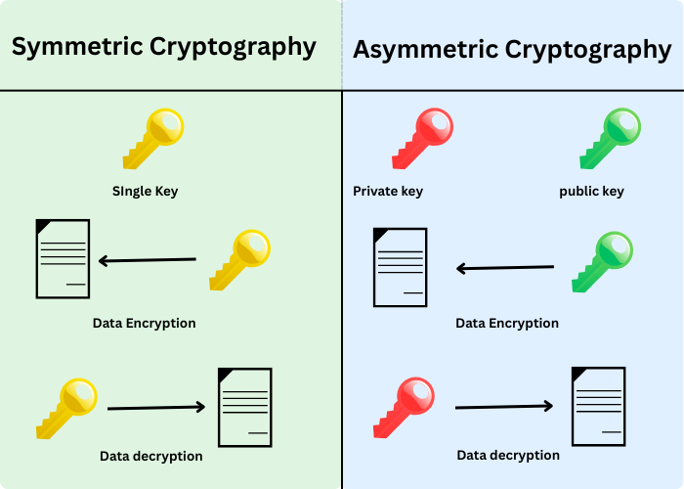
Symmetric vs Asymmetric Encryption

Slide 41
Public Key Infrastructure (PKI)
The city’s trusted key authority
Encryption works only if the city can trust who owns which key
PKI provides:
Trust
Identity verification
Secure communication at scale
PKI answers the question: “Whose key is this?”
Public Key Infrastructure (PKI) is a framework of policies, processes, and technologies used to manage digital certificates and public-key encryption.
This prevents:
Impersonation
Man-in-the-middle attacks

Slide 42
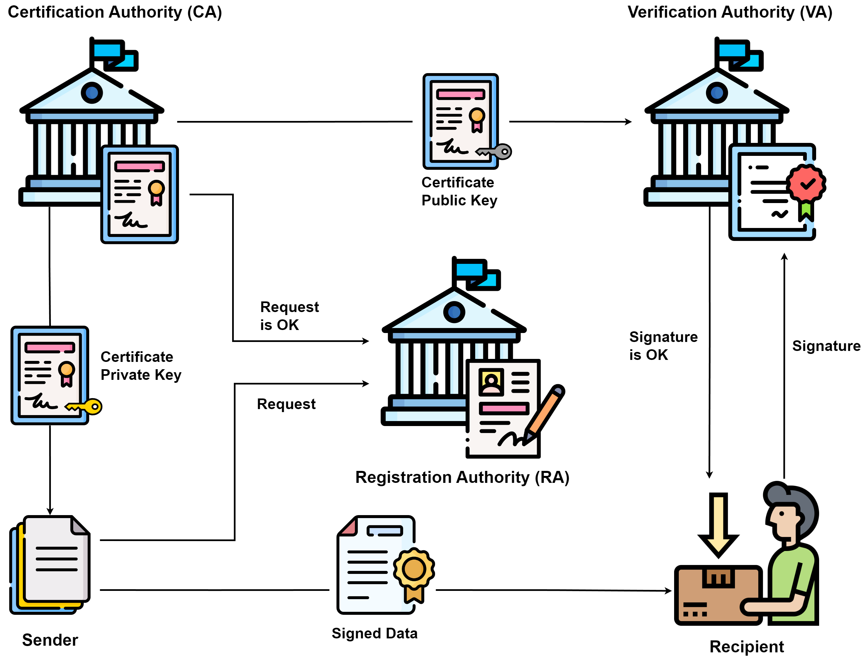
Core PKI Components
Certificate Authority (CA)
Issues and signs certificates
Establishes trust
Registration Authority (RA)
Verifies identity before certificate issuance
Digital Certificates
Bind public key to identity
Have expiration dates
(additional)
Verification Authority
verifies certificate after issuance.
Is the certificate still valid?
Has it been revoked?

Slide 43
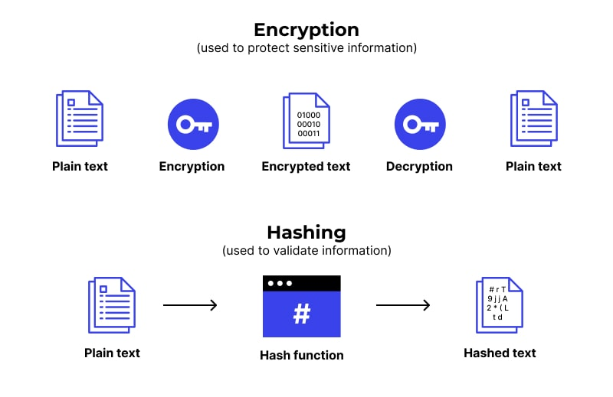
Hashing
Encryption is locking a message in a box so only someone with a key can open it.
Hashing is melting the message into wax — you can check the seal, but you can’t get the letter back.
Hashing is a one-way cryptographic function that converts data into a fixed-length value, used to verify integrity, not to restore original data.
Hashing is a standard way to securely store password data
Encryption → reversible
Hashing → one-way

Slide 44
Modern Computing Environments
Protection in distributed, shared, and mobile systems
17-19

Slide 45
Web-based Communication Technologies
How the city talks to the outside world
Once the city can trust identities and keys, it can safely communicate beyond its walls.
Web-based communication technologies define how data is exchanged between:
Users and systems
Systems and systems
Internal and external parties
HTTP vs HTTPS (No encryption vs Encryption )
API (Application Program Interface) enables system-to-system communication

Slide 46
Virtualized Environments
Many cities built on the same land
Modern cities no longer build one building per function.
They build many virtual cities on top of the same land.
Virtualization changes how assets are isolated, shared, and protected.
Virtualization allows multiple cities to coexist without seeing each other — if designed correctly.
Virtualization is the technology that enables multiple logical computing environments to run on a single physical infrastructure, managed by a hypervisor.
New Risks Introduced by Virtualization
Single point of failure
High-value attack target

Slide 47
Mobile, Wireless, and IoT Devices
Information assets are no longer accessed inside the city walls.
They are accessed:
Anywhere
Anytime
By many small, weak devices
Convenience vs control
Risks:
Lost or stolen devices
Unsecured apps
Weak authentication
Core controls:
Strong authentication
Device encryption
Remote wipe
When access becomes mobile and invisible, control must become deliberate and disciplined

Slide 48
Quiz Next Week
Let’s stress test ourselves before deployment (mid-term exam)
It’ll mostly cover Domain 4 and 5
And a slight addition of Domain 1 through 3

Slide 49
Assignment VI
Fill-up Domain 5 as per usual

